Slide 1
Cool Dataset Presentation
C0₂ Emissions

Slide 2
Dataset
Emissions by Country
Country
Year (1750-2021)
Total CO₂ emissions
Coal
Oil
Gas
Cement
Flaring
Others
Per Capita
The Global Carbon Project (GCP)
License: CC0 (Public Domain)

Slide 3
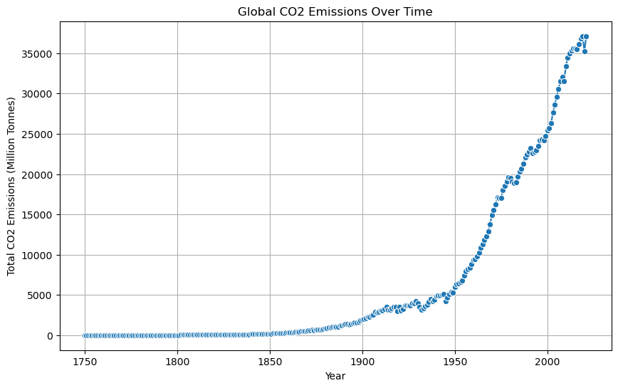
Global CO₂ emissions evolution

Slide 4
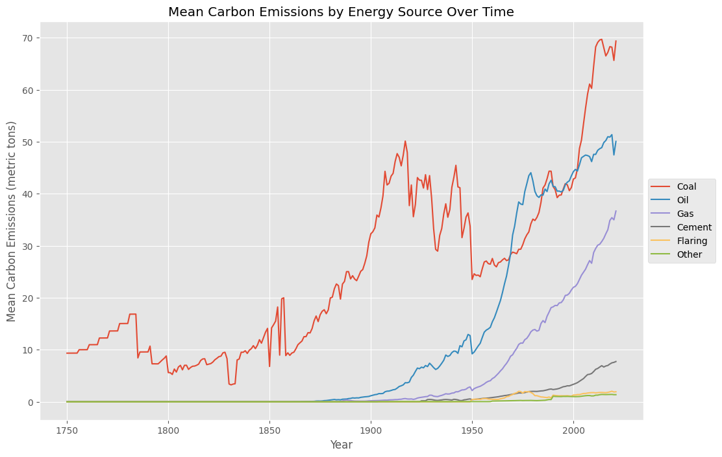
Mean Carbon Emissions by Energy Source

Slide 5
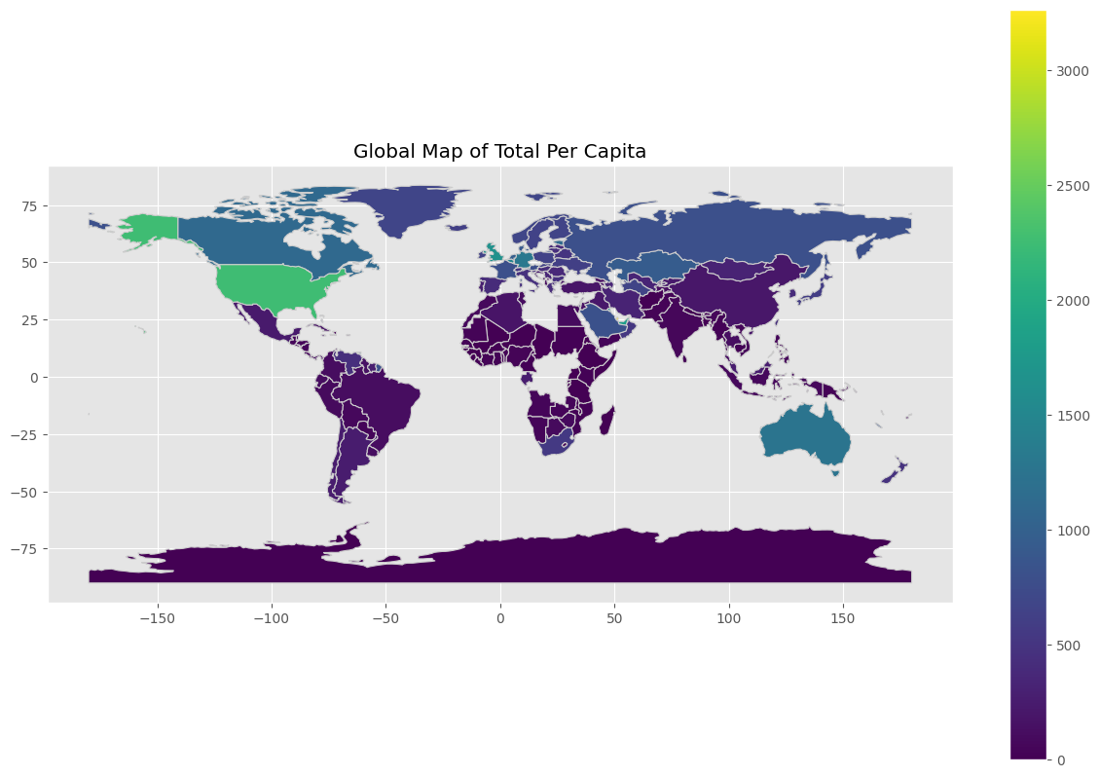
Global Map of Total CO₂ Emissions per capita

Slide 6
Datasets
Emissions by Country
World, Region, Country GDP
Country
Year (1750-2021)
Total CO₂ emissions
Coal
Oil
Gas
Cement
Flaring
Others
Per Capita
Country
Year (1960-2021)
GDP_USD
The Global Carbon Project (GCP)
Data World Bank
Licenses: CC0 (Public Domain)

Slide 7
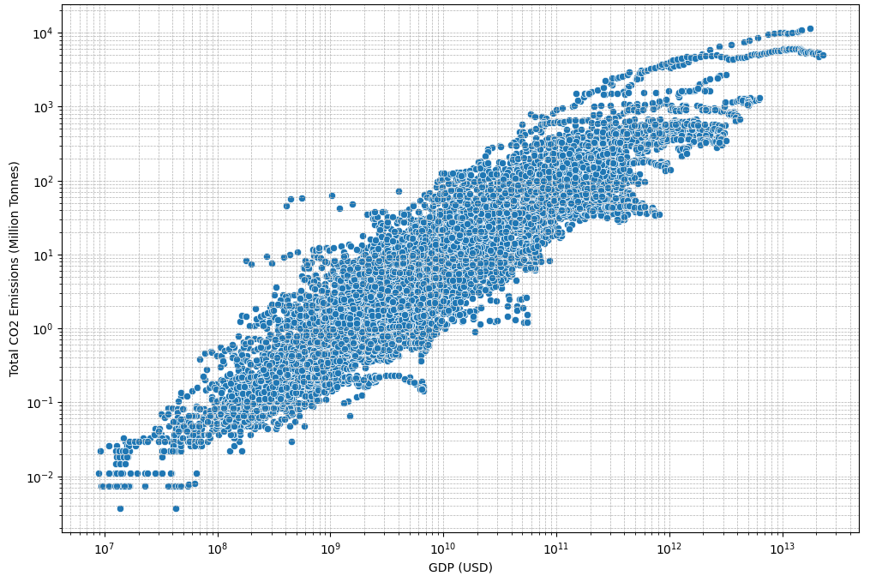
Comparison of GDP and CO₂ Emissions

Slide 8
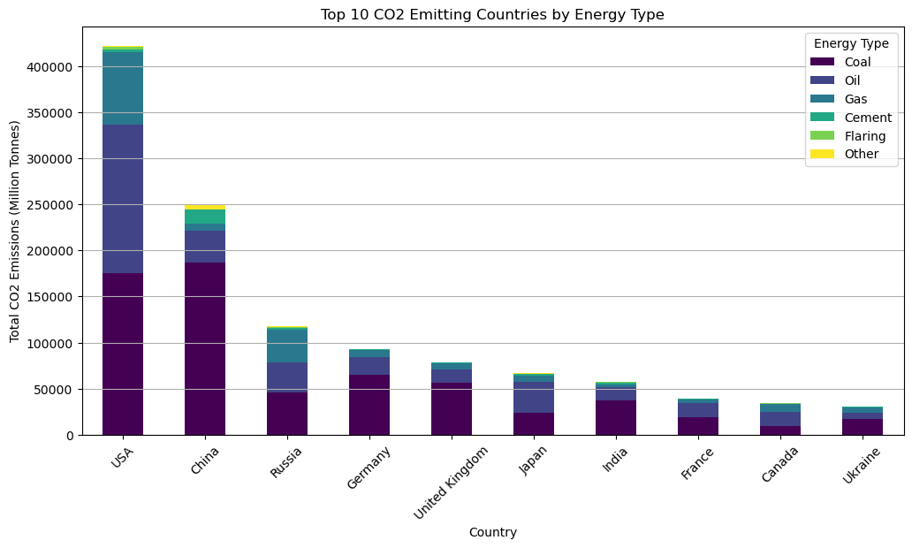
Top 10 CO₂ Emitting Countries

Slide 9
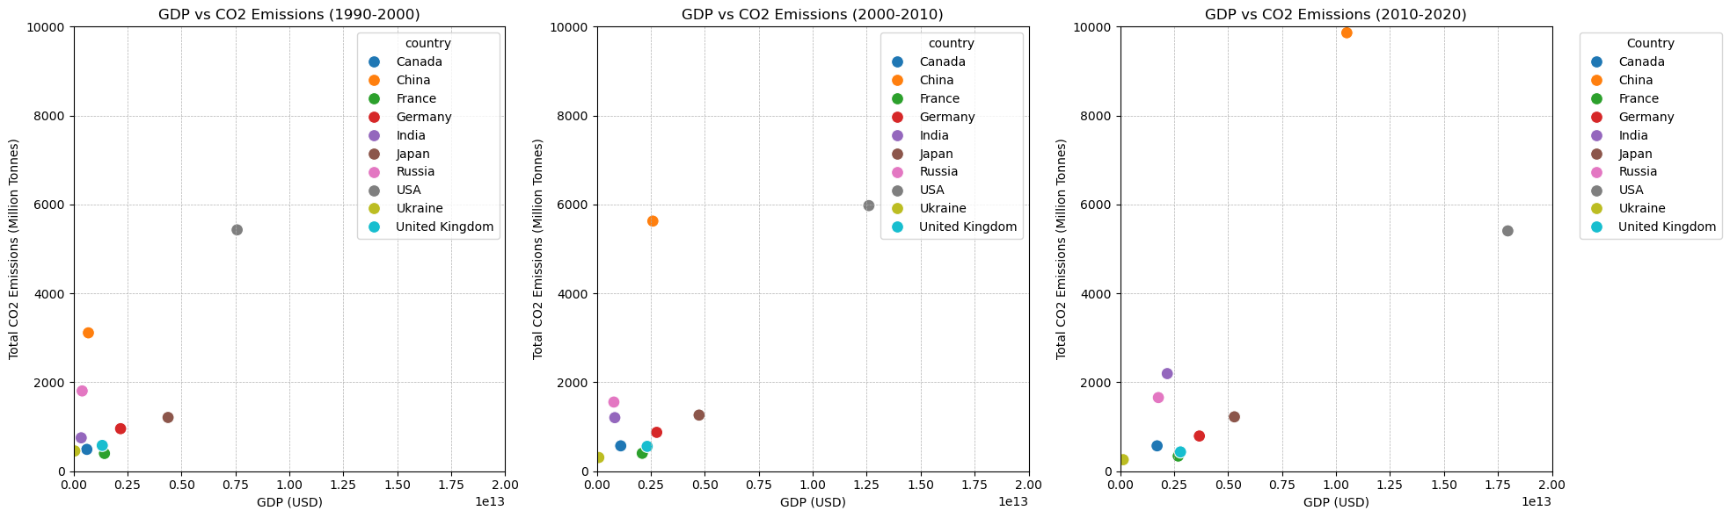
GDP vs CO₂ Emissions
1990-2000
2000-2010
2010-2020

Slide 10
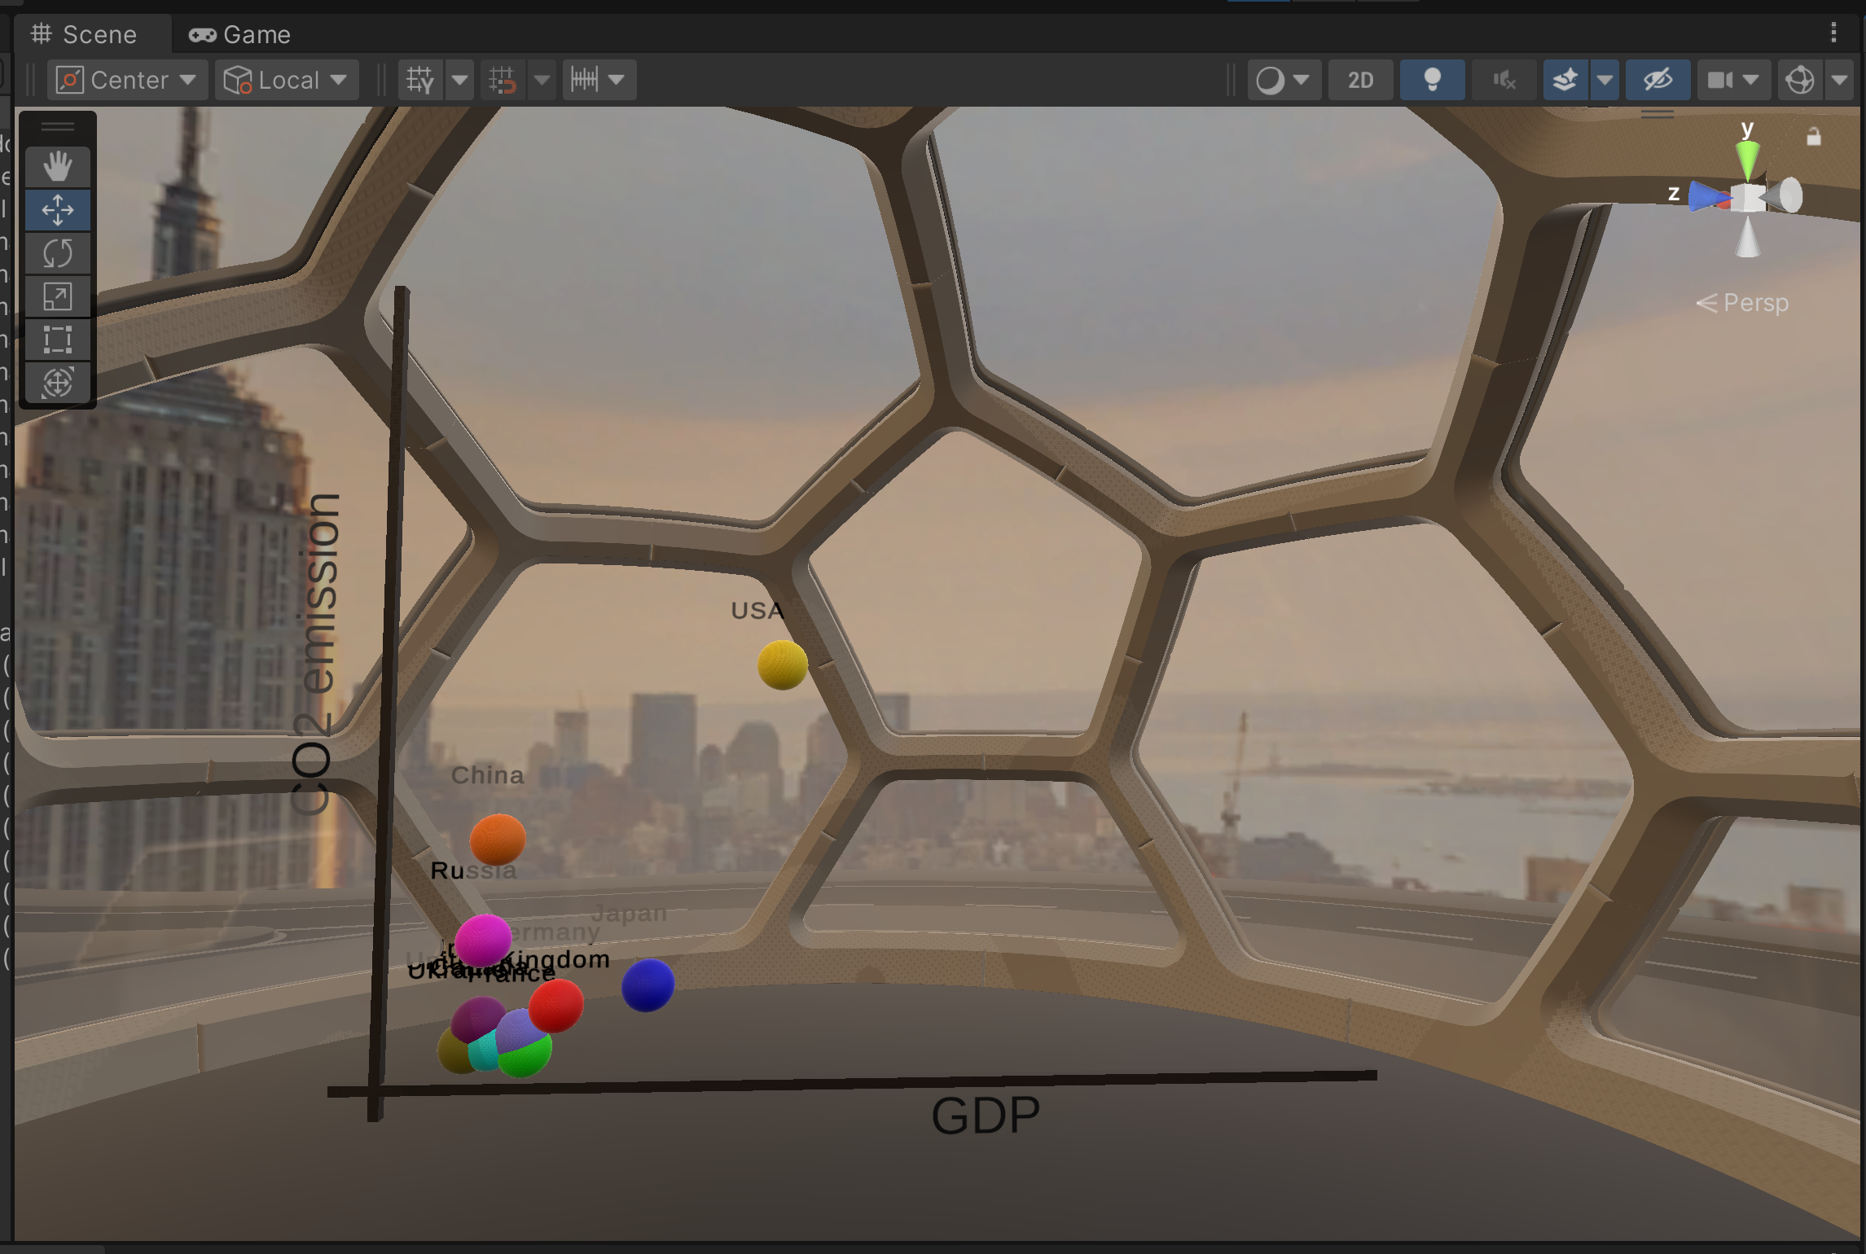
[Unity Demo]

Slide 11
Thank you!

